Slide 1
Semantic Elements
Making HTML make sense
Michelle Alley|CIT230

Slide 2
What are Semantic Elements?
“Semantic” is the study of the meaning of words
In HTML 5, Semantic Elements are used to describe to the browser and you as the developer what your coding contains.
Think of semantic elements as bunch of containers with different things inside them that describe your code and what you want your code to do.
All browsers will accept semantic elements.

Slide 3
When you want to use a semantic element in your HTML coding you use the greater and lesser signs like this:
<>
It will look something like this when you put the semantic elements inside the container:
<header>

Slide 4
What is
&
Isn’t a Semantic Element?
<article>
<aside>
<details>
<figcaption>
<figure>
<footer>
<header>
<main>
<mark>
<nav>
<section>
<summary>
<time>
<div>
<span>

Slide 5
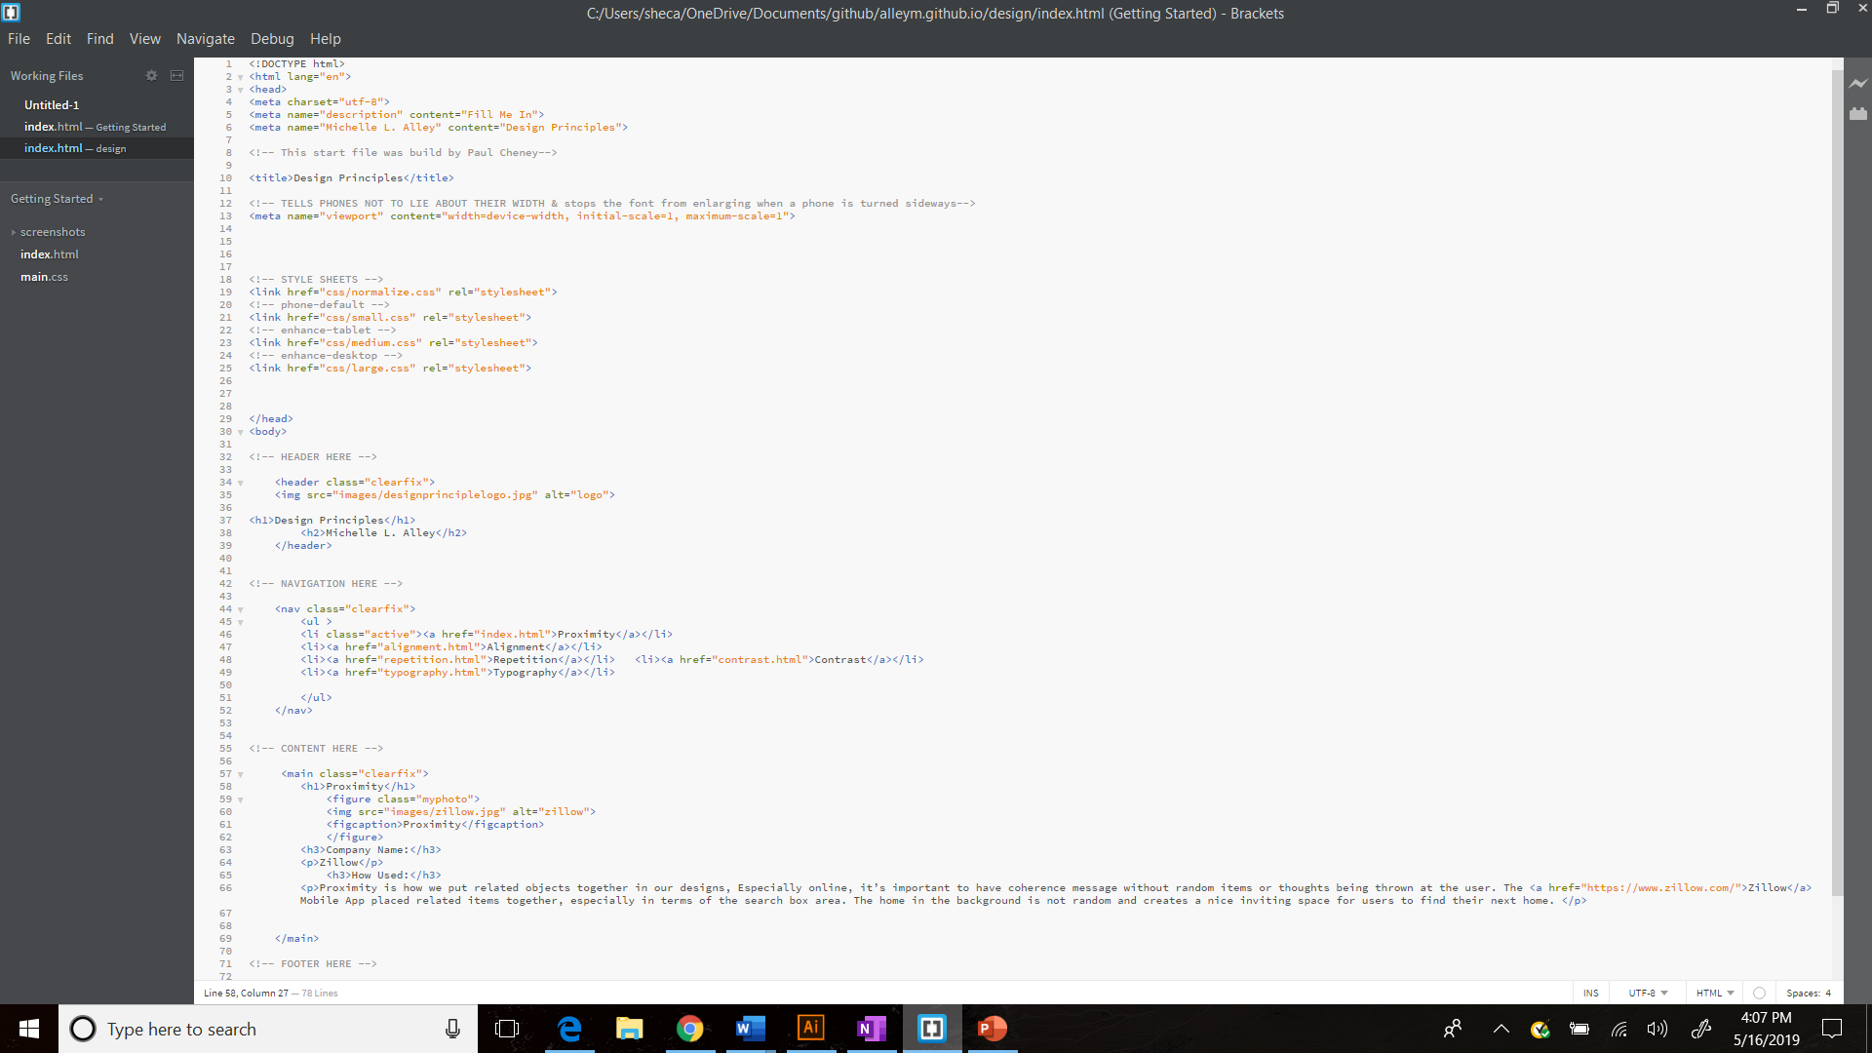
Semantic Elements are like containers:
Begin a Semantic Element like this: <header>
End a Semantic Element like this </header>
Everything in between is contained and can be copied and pasted anywhere.

Slide 6
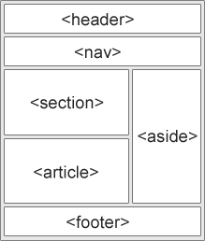
Everyday Semantic Elements
Semantic Elements are placed in almost every HTML 5 code to make the program work. Elements like the following:
<header> - Header for the document
<nav> - Defines Navigation links
<main> - Specifies your main content
<aside> - Defines content on sidebar
<footer> - Defines your footer section
W3schools.com

Slide 7
You can stack inside a semantic tag other semantic elements.
For instance, inside the <main> and </main> elements you can include the <article> and <section> elements.
They create containers with the <main> element to further group information together inside your HTML document.
Other examples: Inside the <header> element you can also put the <form> element that allows you to put a search bar within the header area.

Slide 8
Even more Semantic Tags…
<bdi> defines a section of text that might be formatted in a different direction from other text (for instance, a quote in Hebrew or Arabic in an otherwise-English article)
<details> defines additional details that people can view or hide (like a tooltip)
<dialog> defines a dialog box or window
<figcaption> defines the caption for a <figure>
<mark> defines marked or highlighted text
<menuitem> defines a command/menu item that the user can select from a popup menu
<meter> defines a scalar measurement within a known range (a gauge)
<progress> defines the progress of a task
<rp> defines what to show in browsers that do not support ruby annotations
<rt> defines an explanation/pronunciation of characters (for east asian typography)
<ruby> defines a ruby annotation (for east asian typography)
<summary> defines a visible heading for a <details> element
<time> defines a date/time
<wbr> defines a possible line-break

Slide 9
CSS and Semantic Tags
Semantic tags can be styled by creating a CSS {Cascading Styling Sheet}. By targeting each of the tags you can:
      Change text colors
      Padding
      Sizes
      Margins
Each of these Semantic Elements are targeted by writing the semantic tag in the CSS, liked this:
            header {
            Width: 980px;
            Background-color: #red;
            }

Slide 10
Summary
There is an underlying understanding that Semantic Elements create more meaning to HTML Codes. It allows the user to communicate with other developers and those visiting their websites. It let’s people understand how the website was set-up and adds more meaning to how the user understands the creator and developer.Hello

